Slide 1
Run with Passion

Slide 2
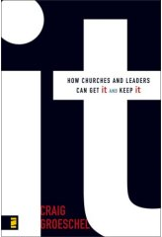
it.
How Church Leaders Can Get It
and Keep It
Author:
Craig Groeschel

Slide 3
Run with Passion
Non Followers
Contributors
Core Followers
Consumers

Slide 4
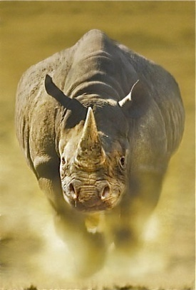
Run with Passion
What are the characteristics of core followers?
First, core followers are passionate, and their passion begins with passion for Jesus. Jesus is their first love.

Slide 5
Run with Passion
Rev. 2:2-5, “I know your deeds, your hard work and your perseverance. I know that you cannot tolerate wicked people, that you have tested those who claim to be apostles but are not, and have found them false. You have persevered and have endured hardships for my name, and have not grown weary. Yet I hold this against you: You have forsaken the love you had at first. Consider how far you have fallen! Repent and do the things you did at first.”

Slide 6
Run with Passion
First, core followers are passionate for Jesus.
The church at Ephesus was a good Church. They did good deeds. They worked hard for the cause. They had good doctrine. They endured hardship and didn’t quit. But there was one thing missing.
Jesus was no longer the first passion of their lives. They lost their passion.

Slide 7
Run with Passion
First, core followers are passionate for Jesus.
Is Jesus the first love of our life? Would he say so? (1 John 4:19, “We love God because he first loved us.”)
We need the Holy Spirit, often symbolized by fire, to burn bright in our souls. He ignites our passion. When the fire dwindles, our passion diminishes. (tend the fire – feed it the good; keep it from bad)

Slide 8
Run with Passion
First, core followers are passionate for Jesus.
So, how is your fire? Is Jesus the first love of our life?
When we lose the fire, rekindling the flame has to be number one priority of our lives. Do whatever it takes to restart the fire.

Slide 9
Run with Passion
Second, core followers are passionate for people. Matthew 22:37-39, “’Love the Lord your God with all your heart and with all your soul and with all your mind.’ This is the first and greatest commandment. And the second is like it: ‘Love your neighbor as yourself.’”

Slide 10
Run with Passion
Second, core followers are passionate for people.
The more connected we are to the Spirit of God, the more His love flows in us, and through us. The more we tend the fire, the more Jesus’ love flows through us.

Slide 11
Run with Passion
Second, core followers are passionate for people.
We need to be passionate for our fellow believers, our brothers and sisters in Christ. 1 John 4:7, “Dear friends, let us love one another, for love comes from God. Everyone who loves has been born of God and knows God.” 1 John 4:20, “If we say we love God yet hate a brother or sister, we are liars. For if we do not love a fellow believer, whom we have seen, we cannot love God, whom we have not seen.”

Slide 12
Run with Passion
Second, core followers are passionate for people. They love their brothers and sisters in Christ.
Two prayers that help: (1) Bless those who curse you. (Mt 5:43-48) Few things put out your fire like bitterness. (heart shrinkage)
(2) Pray for the heart of God toward others. (compassion)

Slide 13
Run with Passion
Second, core followers are passionate for people.
Core followers love people far from God. They are passionate about helping people on their spiritual journey toward Jesus. (opportunity to bless)
Core followers rearrange their schedules, redeploy their resources, and risk rejection because of their passion.

